Slide 1
Sequential Circuit Design
MOHD. YAMANI IDRIS/ NOORZAILY MOHAMED NOOR

Slide 2
Sequential Logic Design
Contents
Why sequential logic?
Flip-flop criteria table
Sequential circuit analysis
Sequential circuit design
MOHD. YAMANI IDRIS/ NOORZAILY MOHAMED NOOR

Slide 3
Why Sequential Logic?
Sequential circuit has additional dimension which is time
Combinational logic only depends on current input
Sequential circuit output depends on previous input other than current input
More powerful than combination logic
Able to model condition which can’t be modeled by combinational logic
MOHD. YAMANI IDRIS/ NOORZAILY MOHAMED NOOR

Slide 4
Sequential Circuit Analysis
Given sequential circuit diagram, behavioral analysis from state table and also state diagram
Need state equations to get flip-flop input and output functions for circuit output other than flip-flop (if any)
We use A(t) and A(t+1) to represent current condition and the next condition for flip-flop represented by A.
Other method, we can use A and A⁺ to represent current condition and the following condition
MOHD. YAMANI IDRIS/ NOORZAILY MOHAMED NOOR

Slide 5
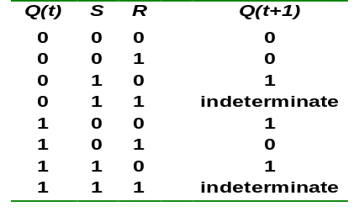
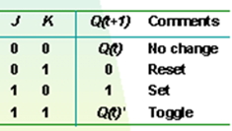
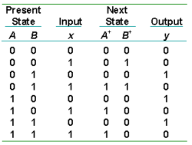
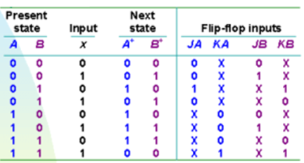
Types of tables in sequential circuit
Characteristic table
Criteria Table
State Table
Excitation table
MOHD. YAMANI IDRIS/ NOORZAILY MOHAMED NOOR

Slide 6
Flip-flop Excitation Tables: Terminology (1)
Analysis: Start from circuit diagram, build state table or state diagram
Design: Start from specification set (i.e. in state equation form, state table or state diagram) build logic circuit.
Criteria table is used in analysis
Excitation tables is used in design
MOHD. YAMANI IDRIS/ NOORZAILY MOHAMED NOOR

Slide 7

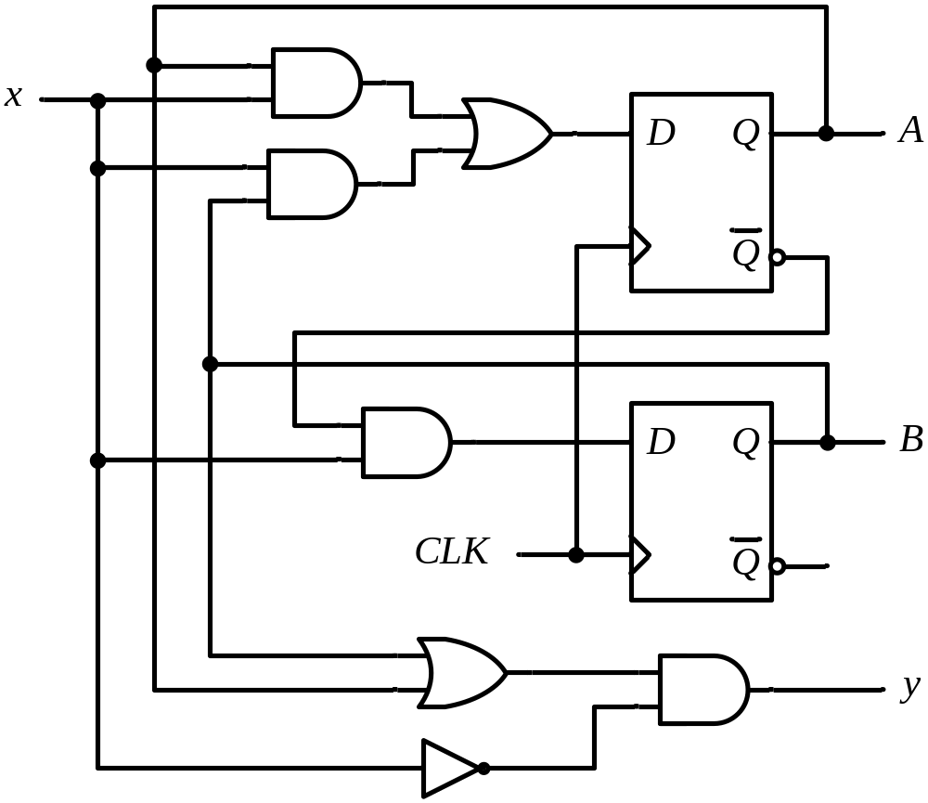
Sequential Circuit Analysis: Equations
Example 1: Find the input equation for flip-flops (using D flip-flop) and output equation
MOHD. YAMANI IDRIS/ NOORZAILY MOHAMED NOOR

Slide 8

Sequential Circuit Analysis: Equations
Example 1 (using D flip-flop)
State equation
Output Function
Flip-flop input
External input
DA
Next state
DB
Present state
Note:
A+ or A(t+1): both refer to next state of fipflop
MOHD. YAMANI IDRIS/ NOORZAILY MOHAMED NOOR

Slide 9
Sequential Circuit Analysis: State Table
From the state equations and output function, we can derive state table which contains all combined binary available for current condition and input
State table
  The same as Truth Table
  Input and condition pad on the left
  Output and next condition on the right
  combined binary available for current condition and input
M flip-flop and n input => 2^{m+n} line
MOHD. YAMANI IDRIS/ NOORZAILY MOHAMED NOOR

Slide 10


Sequential Circuit Analysis
State equation Output function
State table for circuit in Example 1
FF Inputs
DA
DB
MOHD. YAMANI IDRIS/ NOORZAILY MOHAMED NOOR

Slide 11
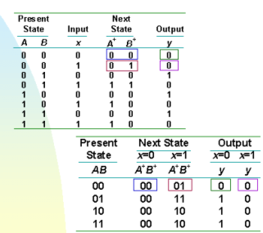
Sequential Circuit Analysis
Other method
MOHD. YAMANI IDRIS/ NOORZAILY MOHAMED NOOR

Slide 12
Sequential Circuit Analysis
From the truth table, we can draw state diagram
State diagram
  Each state is represented by circle
  Each arrow (between two circle) represent transfer for sequential logic (i.e. line transition in truth table)
  a/b label for each arrow where a represent inputs and b represent output for circuit in transition
Each flip-flop value combination represent state. Therefore, m flip-flop=> until 2^{m} state.
MOHD. YAMANI IDRIS/ NOORZAILY MOHAMED NOOR

Slide 13
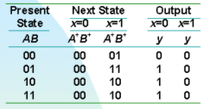
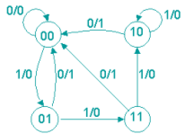
Sequential Circuit Analysis: State Diagram
State diagram for circuit in example 1
MOHD. YAMANI IDRIS/ NOORZAILY MOHAMED NOOR

Slide 14
Flip-flop Input Function
Output of sequential circuit is function for current condition for flip-flop and input. This is explained using algebra by circuit output function
  In example 1: y= (A+B)x’
Circuit part that generate input to flip-flop is explained using algebra by flip-flop input functions
MOHD. YAMANI IDRIS/ NOORZAILY MOHAMED NOOR

Slide 15
Flip-flop Input Function
Flip-flop input function determine next condition
From flip-flop input function and criteria table for flip-flop, we get next condition of the flip-flop
MOHD. YAMANI IDRIS/ NOORZAILY MOHAMED NOOR

Slide 16
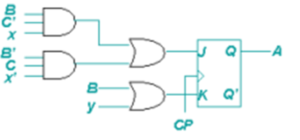
Flip-flop Input Function
Example 2: Find flip-flop input equation in circuit with JK flip flop
MOHD. YAMANI IDRIS/ NOORZAILY MOHAMED NOOR

Slide 17
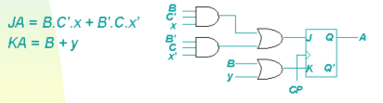
Flip-flop Input Function
Example 2: Find flip-flop input equation in circuit with JK flip flop
We use 2 character to represent flip-flop input: first character represent flip-flop input (J or K for JK flip-flop, S or R for SR flip-flop, D for D flip-flop, T for T flip-flop ) and second character represent name of the flip-flop
MOHD. YAMANI IDRIS/ NOORZAILY MOHAMED NOOR

Slide 18
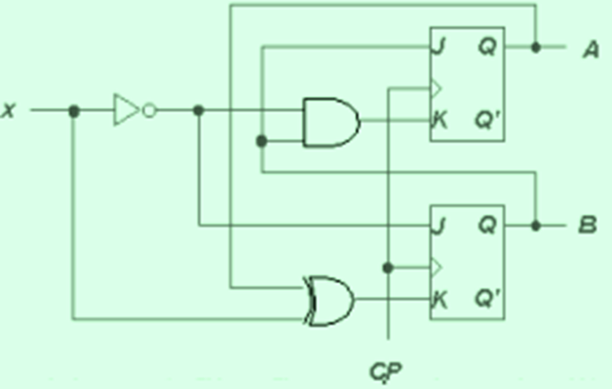
Analysis: Example 3
Given sequential circuit with two JK flip-flop, A and B and one input x
MOHD. YAMANI IDRIS/ NOORZAILY MOHAMED NOOR

Slide 19
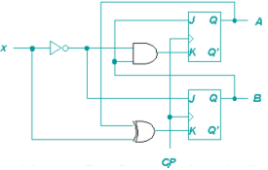

Analysis: Example 3
Given sequential circuit with two JK flip-flop, A and B and one input x
Get the input flip-flop function from the circuit
MOHD. YAMANI IDRIS/ NOORZAILY MOHAMED NOOR

Slide 20
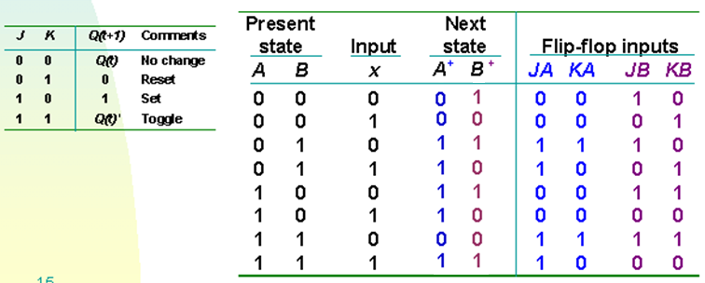
Analysis: Example 3
Input flip-flop function
Fill the state table with the above function using criteria table for used flip-flop
MOHD. YAMANI IDRIS/ NOORZAILY MOHAMED NOOR

Slide 21
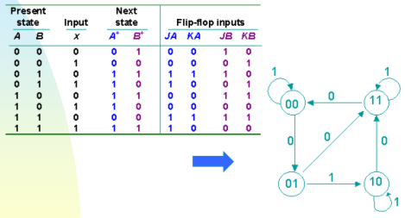
Analysis: Example 3
Draw state diagram from the state table
MOHD. YAMANI IDRIS/ NOORZAILY MOHAMED NOOR

Slide 22
Flip-flop Excitation Tables: Terminology (2)
Analysis: Start from circuit diagram, build state table or state diagram
Design: Start from specification set (i.e. in state equation form, state table or state diagram) build logic circuit.
Criteria table is used in analysis
Excitation tables is used in design
MOHD. YAMANI IDRIS/ NOORZAILY MOHAMED NOOR

Slide 23
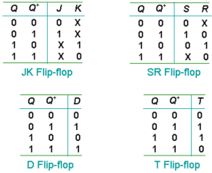
Flip-flop Excitation Tables
Excitation tables : it give transition characteristic between current condition and next condition to determine flip-flop input
MOHD. YAMANI IDRIS/ NOORZAILY MOHAMED NOOR

Slide 24
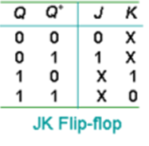
How to build excitation table:
Example: JK Flip-Flop
Q | Q+ | Actually what happens |  | Final Combined Result
 |  | J | K | J | K
0 | 0 | 0 | 1 | 0 | x
 |  | 0 | 0
0 | 1 | 1 | 0 | 1 | x
 |  | 1 | 1
1 | 0 | 0 | 1 | x | 1
 |  | 1 | 1
1 | 1 | 0 | 0 | x | 0
 |  | 1 | 0
MOHD. YAMANI IDRIS/ NOORZAILY MOHAMED NOOR

Slide 25
Designing Sequential Circuit
Design steps
Step 1: Start with circuit specification – characteristic of circuit
Step 2: Build state table
(Ignore) Do state reduction if needed (not in syllabus)
(Ignore) Do state assignment (not in syllabus)
Step 3: Determine number of flip-flop which will be used
Step 4: Build circuit excitation and output table from state table
Step 5: Build circuit output function and flip-flop input function
Step 6: Draw logic diagram
MOHD. YAMANI IDRIS/ NOORZAILY MOHAMED NOOR

Slide 26
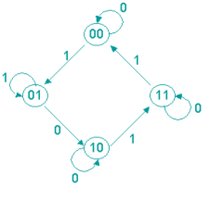
Design: Example 1
Given state diagram as follows, get the sequential circuit using JK flip-flop
MOHD. YAMANI IDRIS/ NOORZAILY MOHAMED NOOR

Slide 27
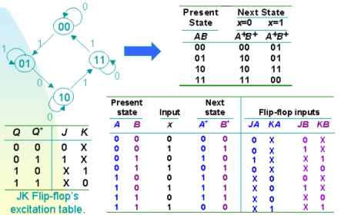
Design: Example 1
Note:
Step 1: Build state table
Step 2: Find no. of Flip-Flop (i.e. 2^m states means m flip-flips)
Step 3: Build Excitation table
Step 4: Use K-map to find input functions
Step 5: Design logic diagram
State/excitation table using JK flip-flop
MOHD. YAMANI IDRIS/ NOORZAILY MOHAMED NOOR

Slide 28
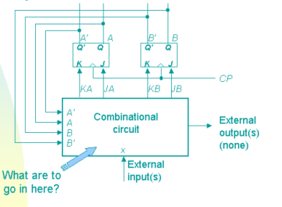
Design: Example 1
Block diagram
MOHD. YAMANI IDRIS/ NOORZAILY MOHAMED NOOR

Slide 29
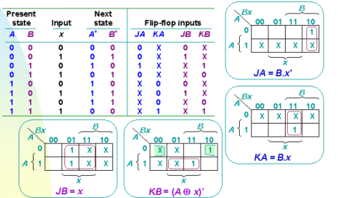
Design: Example 1
From state table, get input flip-flop function
MOHD. YAMANI IDRIS/ NOORZAILY MOHAMED NOOR

Slide 30
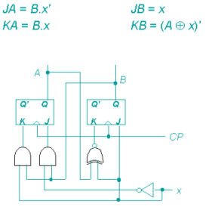
Design: Example 1
Input flip-flop function
Logic Diagram
MOHD. YAMANI IDRIS/ NOORZAILY MOHAMED NOOR

Slide 31
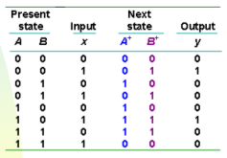
Design: Example 2
Design, using D flip-flop, circuit is based on state table below. (Exercise: How if using JK flip-flop)
MOHD. YAMANI IDRIS/ NOORZAILY MOHAMED NOOR

Slide 32
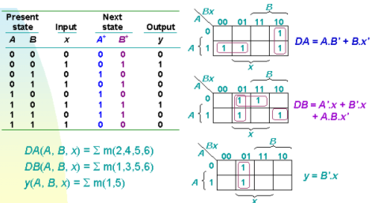
Design: Example 2
Determine input expression for flip-flop and y output
Note: D-FF is too trivial for including it in the excitation table
MOHD. YAMANI IDRIS/ NOORZAILY MOHAMED NOOR

Slide 33
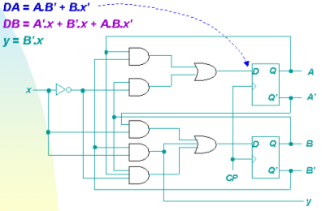
Design: Example 2
From expression built, draw logic diagram
MOHD. YAMANI IDRIS/ NOORZAILY MOHAMED NOOR

Slide 34
Introduction: Counters
Counters are circuits that cycle through a specified number of states.
Two types of counters:
  synchronous (parallel) counters
  asynchronous (ripple) counters
Ripple counters allow some flip-flop outputs to be used as a source of clock for other flip-flops.
Synchronous counters apply the same clock to all flip-flops.

Slide 35
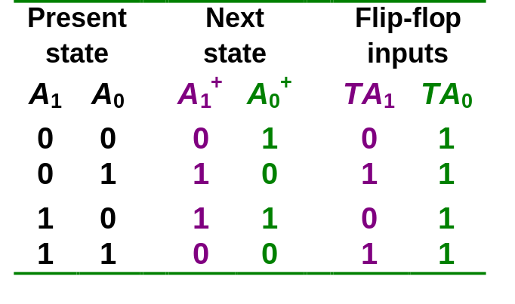
Synchronous (Parallel) Counters
Synchronous (parallel) counters: the flip-flops are clocked at the same time by a common clock pulse.
We can design these counters using the sequential logic design process.
Example: 2-bit synchronous binary counter (using T flip-flops, or JK flip-flops with identical J,K inputs).
00
01
11
10

Slide 36
Synchronous (Parallel) Counters
Example: 2-bit synchronous binary counter (using T flip-flops, or JK flip-flops with identical J,K inputs).
TA₁ = A₀
TA₀ = 1
1
J
A₀
J
A₁
Q
Q
Q
C
C
Q'
Q'
K
Q'
K
CLK

Slide 37
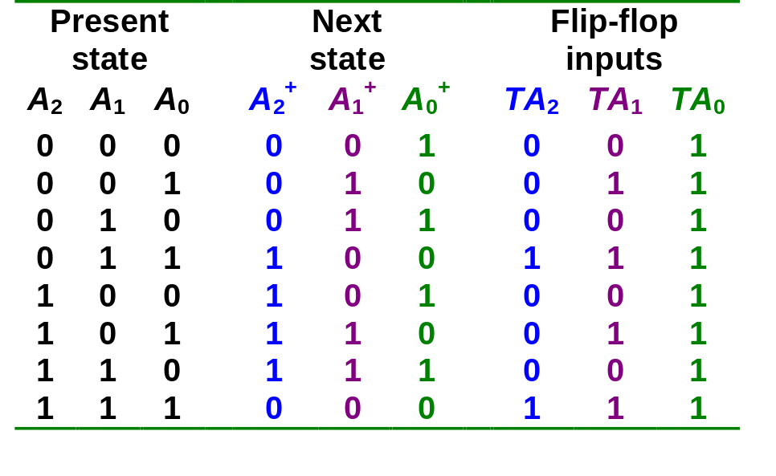
Synchronous (Parallel) Counters
Example: 3-bit synchronous binary counter (using T flip-flops, or JK flip-flops with identical J, K inputs).
A₁
A₁
A₁
1
1
1
1
1
1
1
A₂
1
A₂
1
1
A₂
1
1
1
1
A₀
A₀
A₀
TA₂ = A₁.A₀
TA₁ = A₀
TA₀ = 1

Slide 38
Synchronous (Parallel) Counters
Example: 3-bit synchronous binary counter (cont’d).
  TA₂ = A₁.A₀ TA₁ = A₀ TA₀ = 1
A₂
A₁
A₀
Q
Q
Q
J
K
J
K
J
K
CP
1

Slide 39
Synchronous (Parallel) Counters
Note that in a binary counter, the n^{th} bit (shown underlined) is always complemented whenever
  011…11 → 100…00
  or 111…11 → 000…00
Hence, X_{n} is complemented whenever X_{n-1}X_{n-2} ... X₁X₀ = 11…11.
As a result, if T flip-flops are used, then TX_{n} = X_{n-1} . X_{n-2} . ... . X₁ . X₀

Slide 40
Synchronous (Parallel) Counters
Example: 4-bit synchronous binary counter.
  TA₃ = A₂ . A₁ . A₀
  TA₂ = A₁ . A₀
  TA₁ = A₀
  TA₀ = 1
1
A₁.A₀
A₂.A₁.A₀
J
A₀
J
A₁
J
A₂
J
A₃
Q
Q
Q
Q
Q
C
C
C
C
Q'
Q'
Q'
Q'
K
Q'
K
K
K
CLK

Slide 41
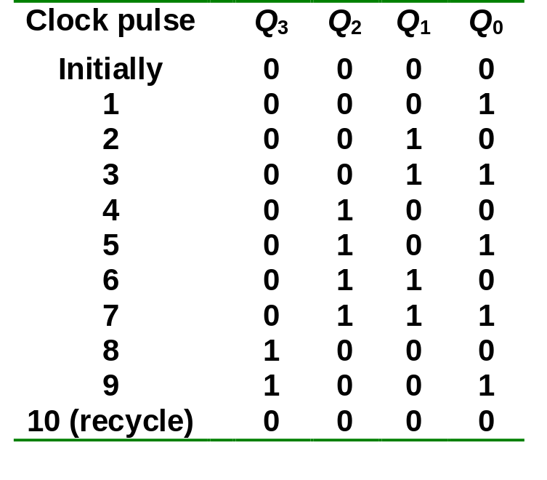
Synchronous (Parallel) Counters
SELF STUDY
Example: Synchronous decade/BCD counter.
T₀ = 1
T₁ = Q₃'.Q₀
T₂ = Q₁.Q₀
T₃ = Q₂.Q₁.Q₀ + Q₃.Q₀
https://www.youtube.com/watch?v=fKVZpupyP_o&list=PLBlnK6fEyqRjMH3mWf6kwqiTbT798eAOm&index=186

Slide 42
Synchronous (Parallel) Counters
Example: Synchronous decade/BCD counter (cont’d).
T₀ = 1
T₁ = Q₃'.Q₀
T₂ = Q₁.Q₀
T₃ = Q₂.Q₁.Q₀ + Q₃.Q₀
Q₀
1
T
Q
T
Q₁
T
Q₂
T
Q₃
Q
Q
Q
Q
Q
Q
Q
C
C
C
C
Q'
Q'
Q'
Q'
Q'
Q'
Q'
Q'
CLK

Slide 43
Up/Down Synchronous Counters
Up/down synchronous counter: a bidirectional counter that is capable of counting either up or down.
An input (control) line Up/Down (or simply Up) specifies the direction of counting.
  Up/Down = 1 → Count upward
  Up/Down = 0 → Count downward

Slide 44
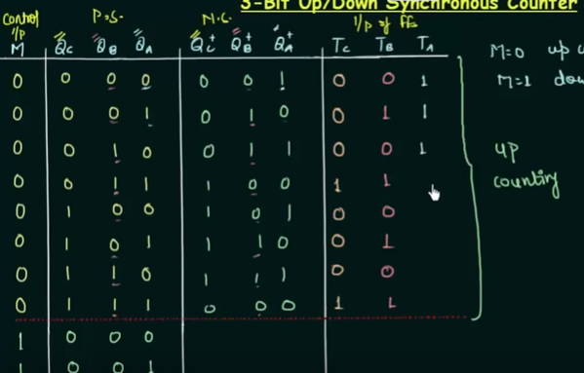
https://www.youtube.com/watch?v=svFUEJkoeVY&list=PLBlnK6fEyqRjMH3mWf6kwqiTbT798eAOm&index=189

Slide 45
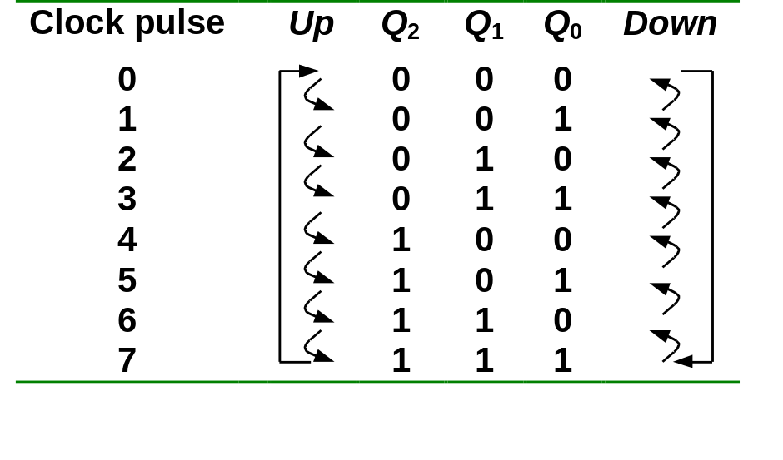
Up/Down Synchronous Counters
Example: A 3-bit up/down synchronous binary counter.
TQ₀ = 1
TQ₁ = (Q₀.Up) + (Q₀'.Up' )
TQ₂ = ( Q₀.Q₁.Up ) + (Q₀'. Q₁'. Up' )
Up counter
TQ₀ = 1
TQ₁ = Q₀
TQ₂ = Q₀.Q₁
Down counter
TQ₀ = 1
TQ₁ = Q₀’
TQ₂ = Q₀’.Q₁’

Slide 46
Up/Down Synchronous Counters
Example: A 3-bit up/down synchronous binary counter (cont’d).
TQ₀ = 1
TQ₁ = (Q₀.Up) + (Q₀'.Up' )
TQ₂ = ( Q₀.Q₁.Up ) + (Q₀'. Q₁'. Up' )
Q₀
Q₁
1
T
Q
T
T
Q₂
Q
Q
Q
Q
Q
Up
C
C
C
Q'
Q'
Q'
Q'
Q'
Q'
CLK

Slide 47
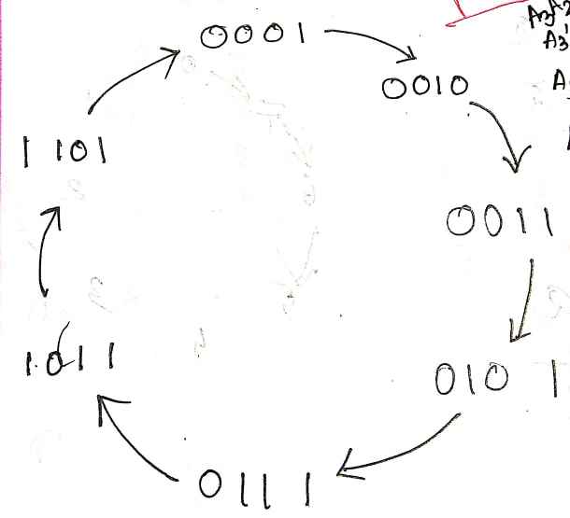
PRACTICE PROBLEM
Implement the following counter using T FF
1->2->3->5->7->11->13->1

Slide 48
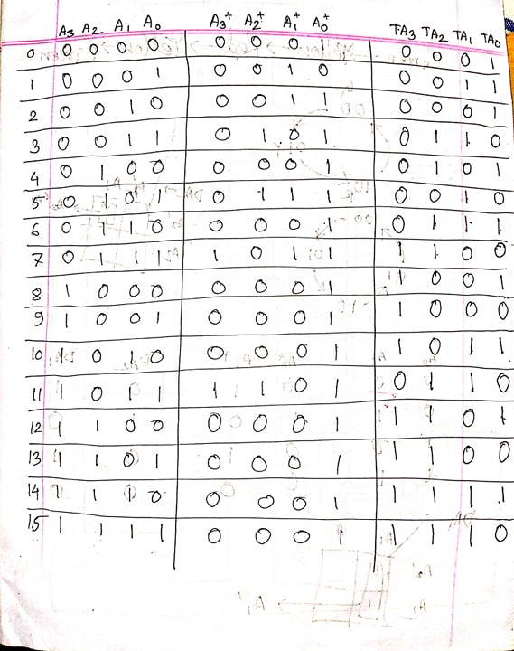
PRACTICE PROBLEM

Slide 49
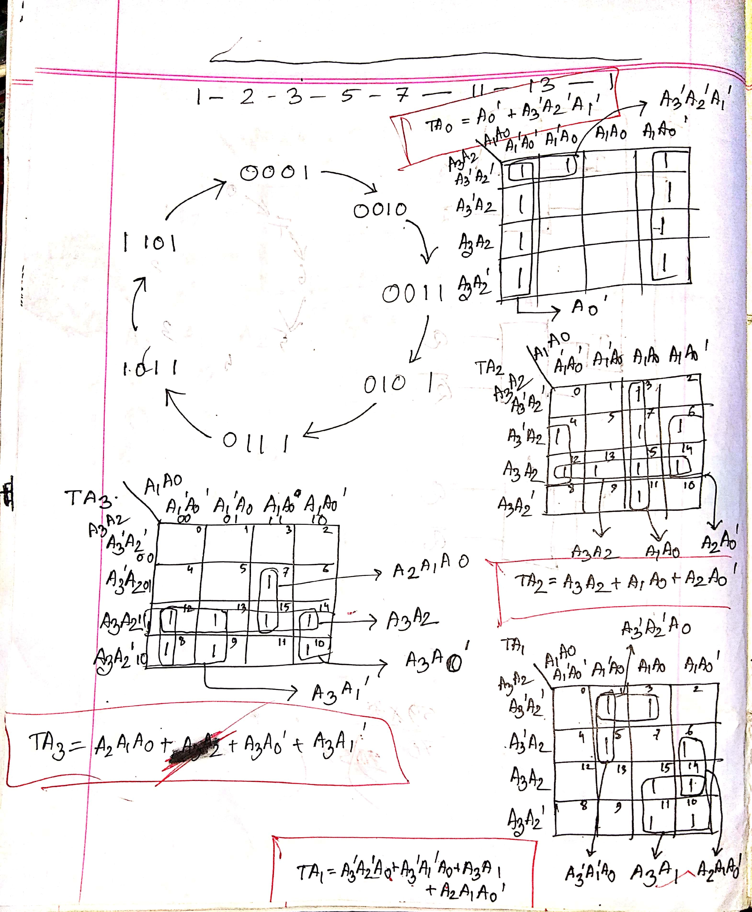
PRACTICE PROBLEM

Slide 50
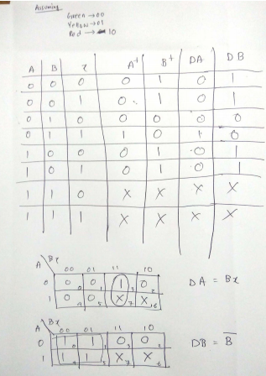
PRACTICE PROBLEM
Implement the following counter using D FF
Green->Yellow->Red->Yellow->Green

Slide 51
Asynchronous (Ripple) Counters
Asynchronous counters: the flip-flops do not change states at exactly the same time as they do not have a common clock pulse.
Also known as ripple counters, as the input clock pulse “ripples” through the counter – cumulative delay is a drawback.
This counter is also a frequency divider.

Slide 52
Asynchronous (Ripple) Counters
Example: 2-bit ripple binary counter.
Output of one flip-flop is connected to the clock input of the next more-significant flip-flop.
HIGH
J
Q₀
J
Q₁
CLK
C
Q₀
C
K
K
FF0
FF1
CLK
1
2
3
4
Q₀
Timing diagram
00 → 01 → 10 → 11 → 00 ...
Q₀
0
1
0
1
0
Q₁
0
0
1
1
0

Slide 53
Asynchronous (Ripple) Counters
Example: 3-bit ripple binary counter.
HIGH
J
Q₀
J
Q₁
J
Q₂
CLK
C
Q₀
C
Q₁
C
K
K
K
FF0
FF1
FF2
CLK
1
2
3
4
5
6
7
8
Q₀
0
1
0
1
0
1
0
1
0
Q₁
0
0
1
1
0
0
1
1
0
Q₂
0
0
0
0
1
1
1
1
0
Recycles back to 0

Slide 54
Asynchronous (Ripple) Counters
Example: 4-bit ripple binary counter (negative-edge triggered).
HIGH
J
Q₀
J
Q₁
J
Q₂
J
Q₃
CLK
C
C
C
C
K
K
K
K
FF0
FF1
FF2
FF3
CLK
1
2
3
4
5
6
7
8
9
10
11
12
13
14
15
16
Q₀
Q₁
Q₂
Q₃

